Slide 1

GRAVITATION

Slide 2
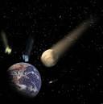

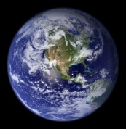
What is gravitational force?
It is a force of attraction between any two bodies due to their mass.
Body
Gravitational force
Earth

Slide 3
Universal Law of Gravitation
Every particle of matter attracts every other particle of matter with a
force which is directly proportional to the product of their masses and inversely proportional to the square of the distance between them.
r
A
B
m₁
r
F
m₂
F
m₁m₂
F =
G.
r²
G is the constant of proportionality known as universal gravitational constant.

Slide 4
Universal Gravitational Constant (G)
Universal gravitational constant is numerically
equal to the force of attraction between two
unit masses placed at unit distance apart.

Slide 5

Vector form of Newton’s law of gravitation

Slide 6
1. If the distance between two masses is doubled, the gravitational attraction between them
1. Is doubled 2. Becomes four times
3. Is reduced to half 4. Is reduced to a quarter
2. The gravitational force between two stones of mass 1kg each separated by a distance of 1 metre in vacuum is
1. Zero 2. 6.675x10⁻⁵ N
3. 6.675x10⁻¹¹ N 4. 6.675x10⁻⁸ N

Slide 7
3. The gravitational force between two-point masses m1 and m2 at separation r is given by The constant K
1. Depends on system of units only
2. Depends on medium between masses only
3. Depends on both (1) and (2)
4. Is independent of both (1) and (2)
Two identical solid copper spheres of radius R placed in contact with each other. The gravitational attraction between them is proportional to
1. R² 2. R⁻² 3. R⁴ 4. R⁻⁴

Slide 8
Shell Theorems
For certain extended objects like spherical shells, shell theorems make calculation of gravitational force very simple.
Theorem 1:
The force of attraction between a hallow spherical shell of uniform density and a point mass situated outside, the shell behaves as if the entire mass of the shell is concentrated at its centre.

Slide 9
Theroem2:
The force of attraction due to a hallow spherical shell of uniform density on a point mass situated inside is zero.
Explanation:
This theorem can be explained qualitatively as follows-
The point mass inside the shell is attracted by different regions of the shell in different directions
Because of symmetry of the shell each force has an equal and opposite force which cancel each other.

Slide 10
Characteristics of gravitational law
m₁m₂
F =
G.
r²
The gravitational force is independent of the intervening medium
The gravitational force is a conservative force
The force exerted by the first particle on the second is exactly equal and opposite to the force exerted by the second particle on the first
The gravitational forces between two particles act along the line joining the two particles and they form an action–reaction pair.

Slide 11
The basic fundamental forces of nature are:
Gravitational force
Strong nuclear force
Weak nuclear force
Electromagnetic force

Slide 12
ACCELERATION DUE TO GRAVITY OF THE EARTH
Earth is a sphere of approximately of uniform mass density
A sphere composed of number of spherical shells.
For a point outside the shells behaves as if the mass is concentrated at the centre. So, to calculate the force between the earth and the point mass can be calculated by using Newton’s universal law of gravitation.

Slide 13

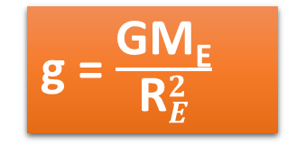
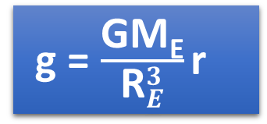

The acceleration experienced by m can be calculated from Newton’s second law
F= mg
= $\frac{\text{GM}\text{E}.\text{m}}{{\text{R}}_{E}^{3}}$ r
Acceleration due to gravity on surface of the earth
g = $\frac{\text{GM}\text{E}.\text{m}}{{\text{R}}_{E}^{3}\text{m}}$ r
g = $\frac{\text{GM}\text{E}}{{\text{R}}_{E}^{3}}$ r
If mass is situated on the surface of the earth r = R_{E}
g = $\frac{\text{GM}\text{E}}{{\text{R}}_{E}^{2}}$
Cavendish calculated ‘G’ value by using the above formula.

Slide 14
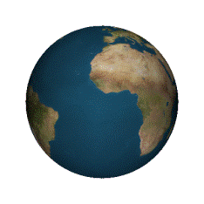
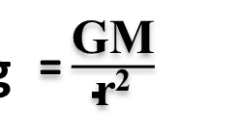
Acceleration due to gravity
As, F = ma
a =
This is called an acceleration due to gravity.
It is represented as, ‘g’.
As F = mg
g =
g =
(M)
r
Force (F)
(M)
Gravitational field
= $\frac{\text{GM}}{\text{r}\text{2}}$
g

Slide 15
Acceleration due to Gravity on surface of the earth (Value)
Object
(m)
Force
GM
g
=
R²
R
Earth
(M)
g
9.8 m/sec²
=
Gravitational
field
This is the value of acceleration due to gravity on the surface of the earth.

Slide 16
Acceleration due to gravity at a height from the surface of the earth
Weight = Gravitational Force
Mg_{h} =
Object
(m)
h
r
R
Force
Earth
(M)
Gravitational
field

Slide 17
Expression of ‘g’ at a small height(h) in terms of ‘g’ on the surface
h < < R
∴
h
R
is very small

Slide 18
Expression for ‘g’ at a height (h) in terms of ‘g’ on the surface
On the earth’s surface

Slide 19
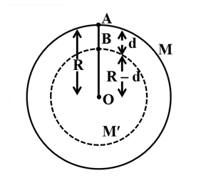
Effect of depth on acceleration due to gravity
4
M′
=
π(R – d)³ ρ
3

Slide 20
The value of acceleration due to gravity decreases with depth.

Slide 21

Variation of ‘g’ with latitude due to rotational motion of the earth
mrω²cosφ
g' is the value of the effective acceleration
due to gravity at the point P.
φ
R
P
mrω²
Mg
φ
R
mg’

Slide 22

Variation of ‘g’ with latitude due to rotational motion of the earth
At Poles
φ = 90° ; cosφ = 0
P
φ = 90°

Slide 23
Variation of ‘g’ with latitude due to rotational motion of the earth
At the equator
g_{e} is the value of the effective acceleration
due to gravity at the equator.
φ = 0°
P
φ = 0° ; cosφ = 1

Slide 24
Latitude is defined as the angle made by the line joining the given point on the earth to the centre on the earth, with the equatorial line.
The value of ‘g’ at the poles is independent of the rotation of the earth.
Due to rotation of the earth, ‘g’ is maximum at the poles and minimum at the equator.
5. If the change in the value of ‘g’ at a height h above the surface of the earth is the same as at a depth x below it, then (both x and h being much smaller than the radius of the earth)
1. x=h 2. X=2h
3. 4. x=h²

Slide 25
6. If the rotational motion of earth increases, then the weight of the body
1. Will remain same 2.Will increase
3. Will decrease 4. None of these
7. Two planets have the same average density but their radii are R₁ and R₂. If acceleration due to gravity on these planets be g₁ and g₂ respectively, then
1. 2.
3. 4.

Slide 26
8. When a body is taken from the equator to the poles, its weight
  1. Remains constant
  2. Increases
3. Decreases
4. Increases at N-pole and decreases at S-pole
9. A body weights 700gm wt on the surface of the earth. How much will it weigh on the surface of a planet whose mass is and radius is half that of the earth
1. 200gm wt 2. 400gm wt
3. 50gm wt 4. 300gm wt

Slide 27
The radius of the earth is 6400 km and g = 10m/s². In order that a body of 5kg weighs zero at the equator, the angular speed of the earth is
1. 1/80 rad/s 2. 1/400 rad/s
3. 1/800 rad/s 4. 1/1600 rad/s
11. Select the wrong statement
The acceleration due to gravity ‘g’ decreases if
1. We go down from the surface of the earth towards its centre
2. We go up from the surface of the earth.
3. We go from the equator towards the poles on the surface of the earth
4. The rotational velocity of the earth is increased

Slide 28
12. If the earth suddenly shrinks (without changing mass) to half of its present radius, the acceleration due to gravity will be
1. g/2 2. 4g 3. g/4 4. 2g
13. If the angular speed of the earth is doubled, the value of acceleration due to gravity (g) at the north pole
1. Doubles 2. Becomes half
3. Remains same 4. Becomes zero

Slide 29
            14. If radius of earth is R then the height ‘h’ at which vale of ‘g’ becomes one-fourth is
          1. 2. 3. R 4.
15. Acceleration due to gravity on moon is 1.6 of the acceleration due to gravity on earth. If the ratio of densities of earth (p_{e}) and moon (p_{m}) is
Then radius of moon R_{m} in terms of R_{e} will be
1. 2. 3. 4.

Slide 30
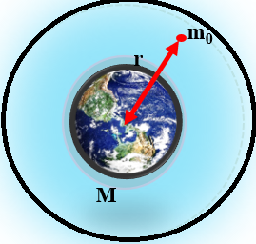
Gravitational intensity
The gravitational intensity at any point in a gravitational field is defined as the force acting on a unit mass placed at that point.
GM
E
=
r²

Slide 31

16. There are two bodies of masses 100kg and 10000 kg separated by a distance 1m. At what distance from the smaller body, the intensity of gravitational field will be zero
1. 2. 3. 4.

Slide 32
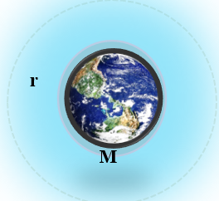

Gravitational potential
The gravitational potential of a body at any point in a gravitational field is defined as the work done to bring a unit mass from infinity to that point without acceleration.
V = -$\frac{\text{GM}}{\text{r}}$
m₀
infinity

Slide 33
  17. Four particles each of mass M, are located at the vertices of square with side L. The gravitational potential due to this at the centre of the square is
  1. 2. 3. Zero 4.

Slide 34

Gravitational Potential Energy (P.E)
Gravitational P.E. = mass x gravitational potential
= mV
=
P.E. = -
Gravitational potential
GM
V
=
–
r

Slide 35
Gravitational potential energy (P.E)
Gravitational potential energy on the surface of the earth
Gravitational potential energy at a height ‘h’ above the surface of the earth

Slide 36
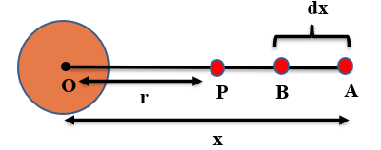
Gravitational potential energy
The work done to displace a body from infinity to a point in the gravitational field against the gravitational field direction is called gravitational potential energy. It is denoted by U.
Equation for gravitational potential energy

Slide 37
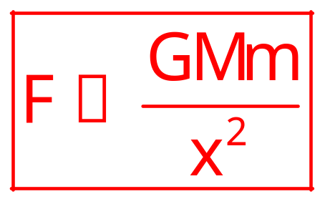

Consider a body of mass ‘m’ placed at a distance ‘x’ from the earth of mass ‘M’ & radius ‘R’.
∴ Gravitational force of attraction
dw is the amount of work done to move the body from A to B at the distance dx against the gravitational force.
∴ dw = F.dx
∴ dw = $\frac{\text{GMm}}{\text{x}2}$.dx

Slide 38

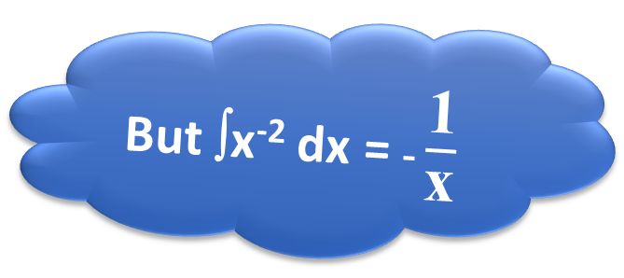
The total work done in bringing the body from infinity to the point ‘p’ is given by,
W = $\frac{\text{GMm}}{\text{x}2}$ dx
But ∫x⁻² dx = - $\frac{\text{1}}{\text{x}}$
W = GMmx⁻² dx

Slide 39

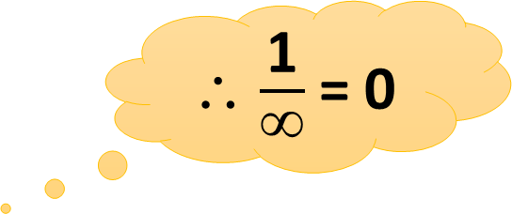

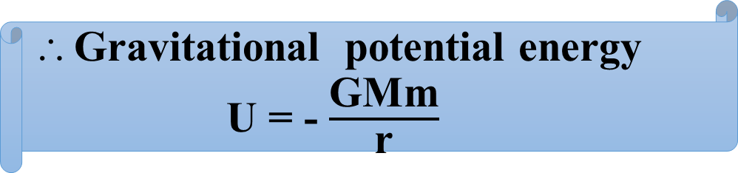

W = -GMm $\left[\frac{\text{1}}{\text{r}} −\frac{\text{1}}{∞}\right]$
∴ $\frac{\text{1}}{∞}$ = 0
W = - $\frac{\text{GMm}}{\text{r}}$
Gravitational potential energy
U = - $\frac{\text{GMm}}{\text{r}}$
Here, r = R + h
∴U = - $\frac{\text{GMm}}{\text{R}\text{+}\text{h}}$

Slide 40

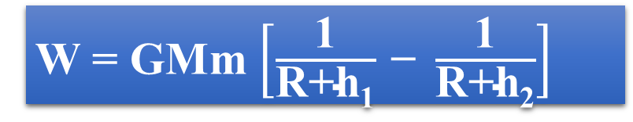

Work done to lift the body from the height h₁ to h₂ is
W₁ = - $\frac{\text{GMm}}{\text{R}\text{+}\text{h}\text{1}}$
………….(1)
W₂ = - $\frac{\text{GMm}}{\text{R}\text{+}\text{h}\text{2}}$
………….(2)
W = W₂ – W₁
W = GMm $\left[\frac{\text{1}}{\text{R}\text{+}\text{h}\text{1}} \text{− }\frac{\text{1}}{\text{R}\text{+}\text{h}\text{2}}\right]$

Slide 41
18. Energy required to move a body of mass m from an orbit of radius 2R to 3R is
1.GMm/12R² 2. GMm/3R²
3. GMm/8R 4. GMm/12R

Slide 42
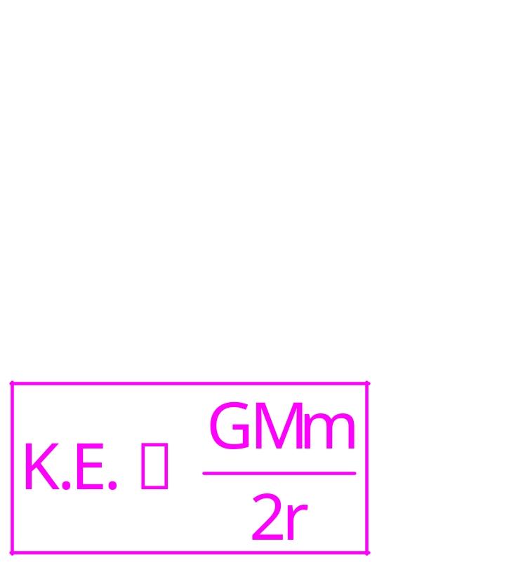
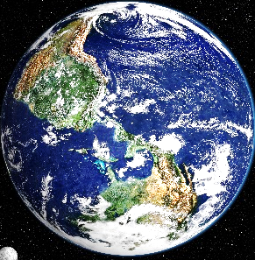
Kinetic energy of a satellite revolving around the earth
V_{c}
R

Slide 43
Kinetic energy of a satellite revolving around the earth
GMm
K.E.
=
Close to the earth
At a height
2 r
V_{c}
H
V_{c}
R
R

Slide 44
19. In a gravitational field, at a point where the gravitational potential is zero
1. The gravitational field is necessarily zero
2. The gravitational field is not necessarily zero
3. Nothing can be said definitely about the gravitational field
4. None of these

Slide 45
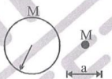
20. A particle of mass M is at a distance a from surface of a thin spherical shell of equal mass and having radius a
Gravitational field and potential both are zero at canter of the shell
Gravitational field is zero not only inside the shell but at a point outside the shell also
3. Inside the shell, gravitational field alone is zero
4. Neither gravitational field nor gravitational potential is zero inside the shell

Slide 46
21. A hollow spherical shell is compressed to half its radius. The gravitational potential at the centre
1. Increases
2. Decreases
3. Remains same
4. During the compression increases then returns at the previous value
22. The mass of the earth is 6.00x10²⁴ kg and that of the moon is 7.40x10²² kg. The constant of gravitation G=6.67x10⁻¹¹ N-m²/kg². The potential energy of the system is -7.79x10²⁸ joule. The mean distance between the earth and moon
1. 3.80x10⁸ m 2. 3.37x10⁶ m
3. 7.60x10⁴ m 4.1.90x10² m

Slide 47
    23. The change is potential energy, when a body of mass m is raised to a height nR from the earth’s surface is (R=Radius of earth)
    1. 2. nmgR 3. 4.
        24. The gravitational potential energy of a body of mass ‘m’ at the earth ‘s surface is -mgR_{e}. Its gravitational potential energy at a height R_{e} from the earth’s surface will be (Here R_{e} is the radius of the earth).
        1. -2mgR_{e} 2. 2mgR_{e} 3. 4.

Slide 48
Escape velocity
The minimum velocity required by a body to escape from the gravitational pull of the planet is called “escape velocity” V_{e}
Equation for escape velocity
Consider a body of mass “m” at rest on the surface of the earth of mass M and radius ‘R’
V_{e} is the minimum velocity of the body to escape from the gravitational force of attraction of the earth.
Kinetic energy of the body = $\frac{\text{1}}{\text{2}}\text{mV}\text{e}\text{2}$----(1)

Slide 49


Gravitational potential energy of the earth
$$U=\frac{−GMm}{R}$$
----------------(2)
In order to escape from the gravitational pull of the planet, the body must be given the K.E equal and opposite to its gravitational potential energy.
From (1) & (2)
$$\frac{1}{2}mV_{e}^{2}=\frac{GMm}{R}$$

Slide 50




$V_{e}^{2}=\frac{2GM}{R}$
$$V_{e}=\sqrt{\frac{2GM}{R}}$$
But
∴Escape velocity $V_{e}=\sqrt{2gR}$
$V_{e}=11.2 km/{sec}$

Slide 51
The value of the escape velocity on the earth’s surface is 11.2 km/sec and on the moon it is 2.38 km/sec
If rms velocity of gas molecules is equal or greater than escape velocity, there is no atmosphere on the moon.
It depends upon
Mass ‘M’ of the earth or planet
Radius ‘R’ of the earth or planet
25. A body is projected vertically upwards from the surface of a planet of radius R with a velocity equal to half the escape velocity for that planet. The maximum height attained by the body is
1. R/3 2. R/2 3. R/4 4. R/5

Slide 52
26. If the radius of a planet is R and its density is p, the escape velocity from its surface will be.
1. 2.
3. 4.
27. The escape velocity form the earth is about 11km/second. The escape velocity from a planet having twice the radius and the same mean density as the earth, is
1. 22 km/s 2. 11 km/s 3. 5.5 km/s 4. 15.5 km/s

Slide 53
28. For a satellite, escape velocity is 11 km/s. If the satellite is launched at an angle of 60⁰ with the vertical,
then escape velocity will be
1. 11 km/s 2. km/s
3. km/s 4. 33 km/s

Slide 54
ORBITAL VELOCITY
The velocity with which a satellite must be projected parallel to the earth’s surface, after parking it in the given orbit, so that it moves around the earth in a circular orbit is knowns as orbital velocity.
Equation for orbital velocity
A satellite of mass ‘m’ revolving around the planet at height ‘h’ in circular orbit from the surface of the planet.
‘M’ & ‘R’ are the mass and radius of the planet.
V₀ is the orbital velocity of the satellite.

Slide 55




∴ Gravitational force of a planet is
F$= \frac{\text{GMm}}{{\text{r}}^{2}}$
Here, r = R + h
$∴F=\frac{\text{GMm}}{{\left(\text{R}\text{+}\text{h}\right)}^{2}}$………(1)
Centripetal force of a satellite
$$\text{F}\text{=}\frac{\text{m}{\text{v}}_{0}^{2}}{\text{r}}$$
$\text{F}\text{=}\frac{\text{m}{\text{v}}_{0}^{2}}{\left(\text{R}\text{+}\text{h}\right)}$……..(2)

Slide 56






$\text{F}\text{=}\frac{\text{m}{\text{v}}_{0}^{2}}{\left(\text{R}\text{+}\text{h}\right)}$……..(2)
Gravitational force of the planet = Centripetal force of the satellite
$$∴ {\text{V}}_{\text{0}}\text{=}\sqrt{\frac{\text{GM}}{\text{R}}}$$
$$∴ \frac{GMm}{{\left(R+h\right)}^{2}}=\frac{mV_{0}^{2}}{\left(R+h\right)}$$
$$V_{o}^{2}= \frac{GM}{\left(R+h\right)}$$
$$V_{o}^{}= \sqrt{\frac{GM}{\left(R+h\right)}}$$
But h<<R
Orbital velocity = ${\text{V}}_{\text{0}}\text{=}\sqrt{\text{gR}}$

Slide 57
29. Select the correct statement from the following
The orbital velocity of a satellite increases with the radius
of the orbit
Escape velocity of a particle from the surface of the
earth depends on the speed with which it is fired
The time period of a satellite does not depend on the
radius of the orbit
The orbital velocity is inversely proportional to the
square root of the radius of the orbit

Slide 58
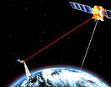
EARTH SATELLITES
Objects which revolve around the earth are called earth satellites.
The motion of the earth satellites is very similar to that of planets around the sun and hence Kepler’s laws of planetary motion can be applied.
The orbits of earth satellites are circular or elliptical.
Moon is the only natural earth’s satellite.

Slide 59
The orbit of moon around is nearly circular. The time period of moon around the earth is approximately 27.3 days.
This time period is roughly equal to the rotation period of moon about its own axis.
Due to this reason we always observe only one side and we are not able to see the other side of moon
Number of man made satellites which are called artificial satellites are launched into different orbits around earth.

Slide 60
time period of earth satellites
The velocity with which a satellite is launched makes it revolve around the earth in a particular orbit.
Consider a satellite revolving around the earth at a heigh ‘h’ above the surface of the earth. The satellite revolves around earth in circular orbit at a height (R_{E} + h) from the centre of the earth.
The required centripetal force is provided by the gravitational force between earth and the satellite.
Let R_{E} = Radius of earth

Slide 61

h = Height of satellite orbit form surface of the earth
m = mass of satellite
M_{E} = mass of the earth
The centripetal force required for this revolution of satellite
F_{centripetal} = $\frac{{\text{mv}}^{2}}{\left({\text{R}}_{E}\text{+}\text{h}\right)}$
It is directed towards the centre of the earth

Slide 62
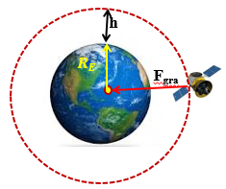





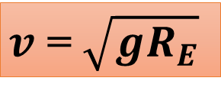

The centripetal force is provided by the gravitational force
F_{gravitational} = $\frac{\text{Gm}{\text{M}}_{E}}{\left({\text{R}}_{E}\text{+}\text{h}\right)\text{2}}$
For circular motion of satellite
F_{centripetal} = F_{gravitational}
$\frac{{\text{mv}}^{2}}{\left({\text{R}}_{E}\text{+}\text{h}\right)}$ = $\frac{\text{Gm}{\text{M}}_{E}}{\left({\text{R}}_{E}\text{+}\text{h}\right)\text{2}}$
Thus if $h$ increases, $v$ decreases. For a satellite nearer to surface of the earth, h is negligible when compared to R_{E}
${\text{v}}^{2}$ = $\frac{\text{G}{\text{M}}_{E}}{\left({\text{R}}_{E}\text{+}\text{h}\right)}$
orbital velocity
$\text{v}$ = $\sqrt{\frac{\text{G}{\text{M}}_{E}{\text{R}}_{E}}{{\text{R}}_{E}^{2}}}$
But we have $g=\frac{GME}{R_{E}2}$
$v$ = $\sqrt{gR_{E}}$

Slide 63




TIME PERIOD OF EARTH SATELLITE
The time taken by the satellite to complete one revolution around the earth is called time period (T)
$T= \frac{\text{Distance} \text{travelled} \text{in} \text{one} \text{revolution}}{\text{Orbital} \text{speed}}$
Distance travelled by earth satellite in one revolution = 2$π\left(RE+h\right)$
$T\text{= }\frac{\text{2}\text{π}\left(\text{R}\text{E}\text{+}\text{h}\right)}{\text{v}}$
$\text{ }\text{T}$ = $\frac{\text{2}\text{π}\left(\text{R}\text{E}\text{+}\text{h}\right)}{\sqrt{\frac{\text{G}{\text{M}}_{E}}{\left({\text{R}}_{E}\text{+}\text{h}\right)}}}$
$\text{T}$ = $\frac{\text{2}\text{π}\left(\text{R}\text{E}\text{+}\text{h}\right)\text{3/2}}{\sqrt{\text{G}{\text{M}}_{E}}}$

Slide 64





T² = $\frac{\text{4}\text{π}\text{2}\left(\text{R}\text{E}\text{+}\text{h}\right)\text{3}}{\text{G}{\text{M}}_{E}}$
= Constant $\left(RE+h\right)3$
= Constant $\left(RE+h\right)3$
Substituting numerical values g$≅$9.8 ms⁻²
Substituting numerical values g$≅$9.8 ms⁻²
We get T =$\text{2}π\sqrt{\frac{6400×{10}^{3}}{9.8}}$
$≅$ 85 minutes

Slide 65

29. A satellite whose mass is m, is revolving in circular orbit of radius r around the earth, mass M. Time of revolution of satellite is
1. 2. 3. 4.

Slide 66
Total energy (T.E.)
Satellite revolving around the earth
An object, stationary on the earth

Slide 67
30. The ratio at the K.E. required to be given to the satellite to escape earth’s gravitational field to the K.E. required to be given so that the satellite moves in a circular orbit just above earth atmosphere is
1. One 2. Two 3. Half 4. Infinity

Slide 68
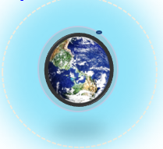
BINDING ENERGY OF AN OBJECT
The minimum energy that is supplied to an object for its escape form the earth’s gravitational field is called the binding energy of that object
Mathematically, it is given as..
B.E = -T.E.

Slide 69
31. A satellite with kinetic energy E_{k} is revolving round the earth in a circular orbit. How much more kinetic energy should be given to it so that it may just escape into outer space
1. E_{K} 2. 2E_{K} 3. 4. 3E_{K}

Slide 70
Angular momentum of a satellite
The height of a satellite of an orbit increases from the surface of a planet, then its
P.E. increases.
K.E. decreases.
Orbital velocity decreases
Total energy increases
Period of revolution increases

Slide 71
32. A satellite of mass m is circulating around the earth with constant angular velocity. If radius of the orbit is R_{o} and mass of the earth M, the angular momentum about the centre of the earth is
1. 2. 3. 4.

Slide 72
SATELLITES
Polar satellites
Geo-stationary satellites
Geo-stationary satellites
The time period of the satellite in a circular orbit around the earth must be equal to the rotational period of the earth. ( i.e 24 hrs)

Slide 73

Weightlessness
Weight of an object is the force with which the earth attracts it
In case of satellite around the earth, every part of the satellite has an acceleration towards the centre of the earth.
$$\text{F}\text{=}\frac{\text{GMm}}{{\text{r}}^{2}} \left(\text{∵}\text{r}\text{=}\text{R}\text{+}\text{h}\right)$$
This gravitational force of the earth provides a centripetal force to the satellite to move in its orbit around the earth
$$\text{F}\text{=}\frac{\text{m}{\text{v}}^{2}}{\text{r}}$$

Slide 74



In this position this satellite and anything inside it are in the state of free fall.
$$\frac{\text{GMm}}{{\text{r}}^{2}}\text{=}\frac{\text{m}{\text{v}}^{2}}{\text{r}}$$
$$\text{∴}\text{W}\text{=}\frac{\text{GMm}}{{\text{r}}^{2}}\text{−}\frac{\text{m}{\text{v}}^{2}}{\text{r}}$$
$$\text{W}\text{= 0}$$
Satellite and anything inside it are in the state of weightlessness because they are falling freely.

Slide 75
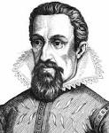
Kepler’s second law or law of areas
Kepler’s first law or law of orbits
Kepler’s laws
Kepler’s third law or law of periods

Slide 76
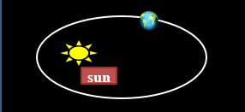
Kepler's first law or law of orbits
Each and every planet moves around the sun in an elliptical orbit with the sun at one of the foci.

Slide 77
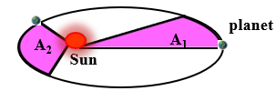
Kepler’s 2nd Law of planetary motion
The radius vector drawn from the sun to any planet,
sweeps out equal areas in equal intervals of time.
The law of conservation of angular momentum is valid for any central force.

Slide 78
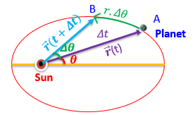

Proof of law of areas
A planet moves in an elliptical orbit from position A to position B in time Δt .
The area swept by the position vector $\vec{r}$ is equal to area of the triangular region.

Slide 79
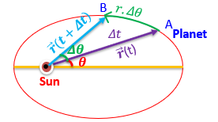




$$\text{i}\text{.}\text{e} \text{ΔA}\text{=}\frac{\text{1}}{\text{2}}\text{r}\text{×}\text{r}\text{.}\text{Δθ}\text{=}\frac{\text{1}}{\text{2}}{\text{r}}^{2}\text{Δθ}$$
$$\frac{ΔA}{Δt}=\frac{1}{2}r^{2}\left[\frac{Δθ}{Δt}\right]$$
$$but \frac{Δθ}{Δt}=ω$$
$$\frac{ΔA}{Δt}=\frac{1}{2}r^{2}ω$$

Slide 80
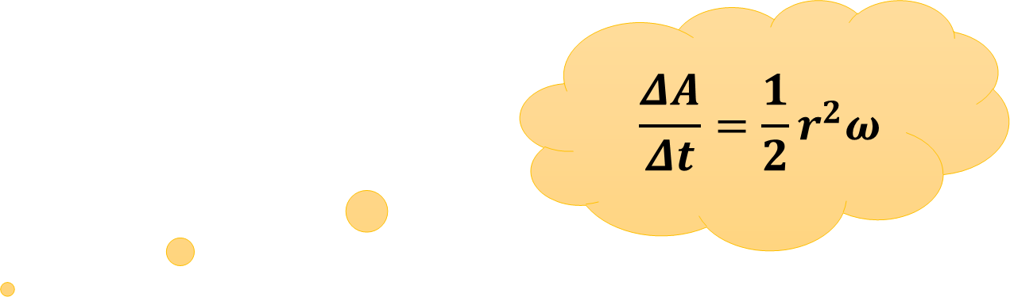





The angular momentum of the planet of mass m is
$$\text{L}\text{=}\left(\text{m} {\text{r}}^{2}\right) \text{ω}$$
$$\text{⇒} \text{ω}\text{=}\frac{\text{L}}{\text{m}{\text{r}}^{2}}$$
$$\frac{ΔA}{Δt}=\frac{1}{2}r^{2}ω$$
$$∴ \frac{ΔA}{Δt}=$$
$$\frac{\text{1}}{\text{2}}{\text{r}}^{2}\text{×}\frac{\text{L}}{\text{m}{\text{r}}^{2}}\text{=}\frac{\text{L}}{\text{2}\text{m}}$$
Here, angular momentum L is constant.
$$\text{∴}\frac{\text{dA}}{\text{dt}}\text{=}\text{constant}$$
i.e the areal velocity of the planet is constant.

Slide 81
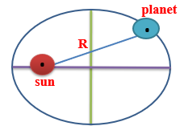


The square of the time for a planet to complete one revolution around the sun is directly proportional to the cube of semi-major axis of the elliptical orbit.
$$T^{2} α R^{3}$$
$$\frac{{\text{T}}^{2}}{{\text{R}}^{3}} \text{=} \text{constant}$$
Where R is semi-major axis of elliptical orbit.

Slide 82
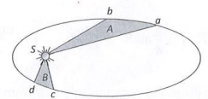
33. The figure shows the motion of a planet around the sun in an elliptical orbit with sun at the focus. The shaded areas A and B are also shown in the figure which can be assumed to be equal. If t₁ and t₂ represent the time for the planet to move from a to b and d c respectively, then
1. t₁<t₂ 2. t₁>t₂ 3. t₁=t₂ 4. t₁ t₂

Slide 83
34. The period of a satellite in a circular orbit of radius R is T, the period of another satellite in a circular orbit of radius 4R is
1. 4T 2. T/4 3. 8T 4. T/8
35. Orbit of a planet around a star is
1. A circle 2. An ellipse
3. A parabola 4. A straight line

Slide 84

36. Kepler’s second law regarding constancy of aerial velocity of a planet is a consequences of the law of conservation of
1. Energy 2. Angular momentum
3. Linear momentum 4. None of these
37. A satellite which is geostationary in a particular orbit is taken to another orbit. Its distance from the centre of earth in new orbit is 2 times that of the earlier orbit. The time period in the second orbit is
    4.8 hours 2. 48$\sqrt{2} hours$
  3. 24 hours 4. 24$\sqrt{2}hours$

Slide 85
38. Statement Type Question:
Read the Statement-I and Statement-II carefully to mark the correct option out of the options given below
1. Both Statement-I and Statement-II are correct
2. Statement-I is correct but Statement-II is incorrect
3. Statement-I is incorrect but Statement-II is correct
4. Both Statement-I and Statement-II are incorrect

Slide 86
39. Statement-I: In Kepler’s law conservation of angular momentum does not take place.
Statement -II: Gravitation force acting between earth and sun is perpendicular to line joining them.
Statement I: The universal gravitational constant is same as acceleration due to gravity
Statement II: Gravitational constant and acceleration due to gravity have same dimensional formula

